Slide 1

David Moreno
Mario Raushel
Terence Sin
Caleb Wells

Slide 2
Contents

Slide 3
Problem Background
Create log of your daily movement
Visualize day through captured images

Slide 4
Needs Statement
There is a need for users to autonomously create and explore daily photo life logs for both a fun and interesting experience.

Slide 5
Goal
The goal for this project is to create a wearable camera system capable of recording GPS data that will automatically record the daily life of the user based on a variety of triggers, and organize data.

Slide 6
Requirements
The prototype design should cost no more than $500
The prototype must be battery powered and capable of logging at least a full day
The camera unit should not cause any harm to the user or others
The camera should function well both indoors and outdoors

Slide 7
Requirements
The GPS should function well in outdoor urban areas and have a decent failover for loss of signal indoors
The design must be comfortable to wear and lightweight (< 1 lb)
Accompanying software must be easy to use and understand
The camera unit must take good quality pictures (at least 320 x 240 resolution)

Slide 8
Design Alternatives
GPS chips
Enclosure Designs
Web Services

Slide 9
System level Description

Slide 10
Design

Slide 11
Design

Slide 12
Design

Slide 13
Design

Slide 14
Design

Slide 15
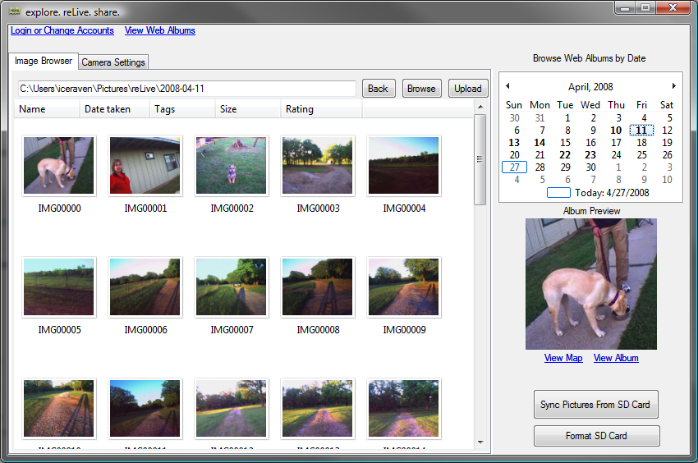
Software Design

Slide 16
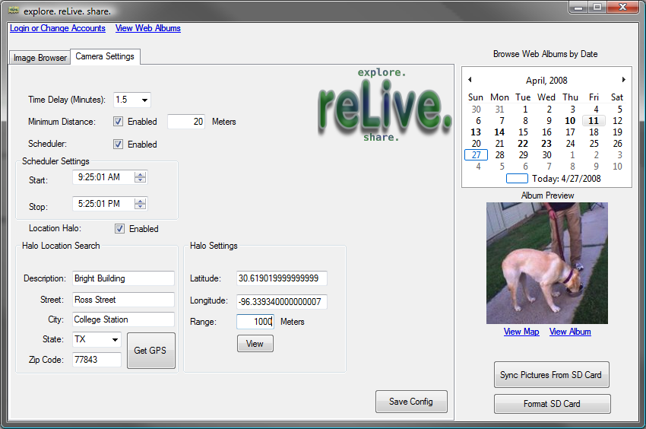
Software Design

Slide 17
Team Management
David Moreno
Hardware and CMUCam3 operations
Purchasing
Mario Raushel
Software design and implementation
Terence Sin
Software and hardware interaction design
Caleb Wells
Leader
Hardware and GPS operations

Slide 18

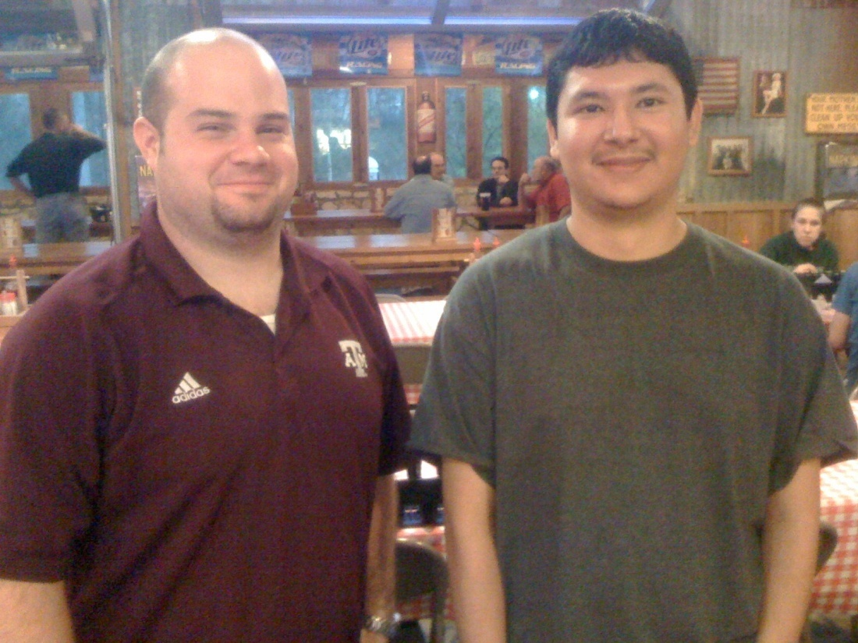
Effective Teamwork
2-3 meetings each week to discuss updates and plans
Constant email communication providing individual progress reports
Team building activities such as meeting at Rudy’s for dinner
Overcame problems as a team

Slide 19
Societal, Safety, Political, and Environmental Analysis
Societal Analysis
For privacy concerns the camera must be large enough that others can tell they are being photographed
Safety Analysis
One of our key objectives is to create a camera unit that will not cause any harm to the user
Political Analysis
Upon purchase user must agree it will not be used for malicious reasons.
Environmental Analysis
Will be supplied with rechargeable batteries
Lead free device

Slide 20
Manufacturability, Sustainability and Economics
Manufacturability
Hardware easily mass produced
Software easily distributed
Sustainability
Batteries can be recharged
Information synchronized to both computer and Google
Economics
Low bulk material cost

Slide 21
Budget

Slide 22
Final Product

Slide 23
Evaluation Results

Slide 24
Overview

Slide 25
Any Questions?

